Slide 1

Idealists Posture Correction
Team Members
Rishabh Jain
Jaiwin Shah
Vedant Jolly

Slide 2
Why did we choose this topic??
Problem 1: The pandemic has accelerated the shift towards a more digital world and triggered changes that are likely to have lasting effects .There’s no running from our screens but making sure we are well distanced is something we can adapt.
Problem 2: Physical health is something the current world is struggling with. Fixing your posture while being in front of your screen is the main challenge.
USP : The webapp features a way to make sure you sit at the correct distance from the screen and making sure your body is in the right position.

Slide 3
Decreased Mobility
Joint Pain
Cardiovascular Disease
Obesity
Bad posture
Degenerative Arthritis
Depression
Muscle Strain
Stress

Slide 4
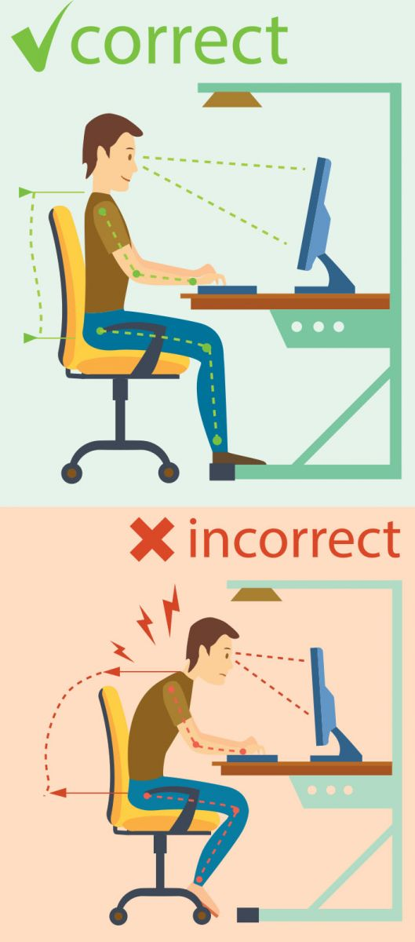
The neck and shoulder are the first to be affected in the wrong postures when one pays attention to the screen.

Slide 5

Proposed Solution

Slide 6
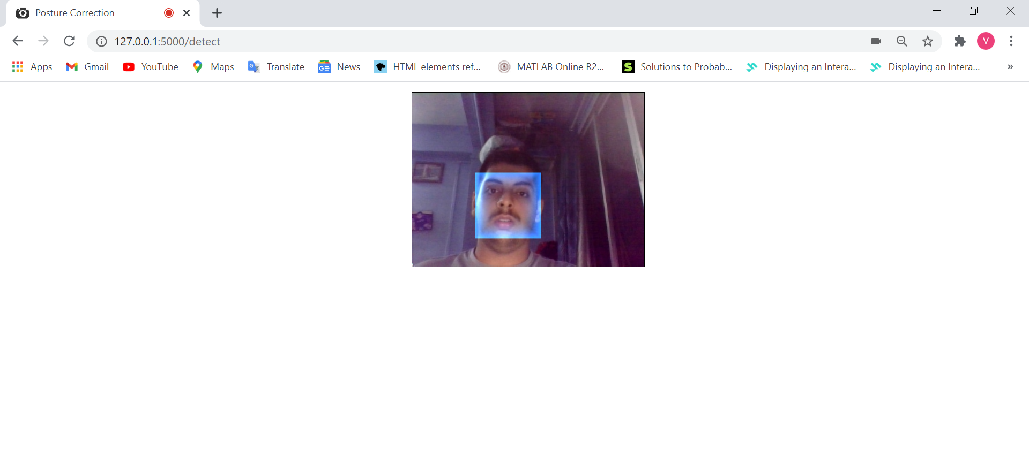
Detection of Face
The face is detected in real time using JeelizAR which is an API written in JavaScript.
In that library, we are using the feature of Jeeliz GlanceTracker API. It lets us detect if the user is looking towards his/her screen.
They are powered by deep learning engine running on the GPU with WebGL. It is so fast that it can analyze a video stream in real-time. Neural network is being used to form layers and detect the face.

Slide 7
Tech
With Three.js, it is possible to create stunning 3D graphics in an intuitive manner using JavaScript.
Three.js helps us with built-in camera controls to create 3D scenes and hence used collision detection technique
It is using skeleton based animation to detect key points in the upper half of human body.
Key points like eyes, mouth, nose, eyebrows are being identified.
HTML5 canvas as a texture is being used.
HTML5 Web Audio API in combination with Three.js to visualize audio. It shows this through visualizations of the waveform and the amplitude

Slide 8

Working of the Software & Salient Features

Slide 9
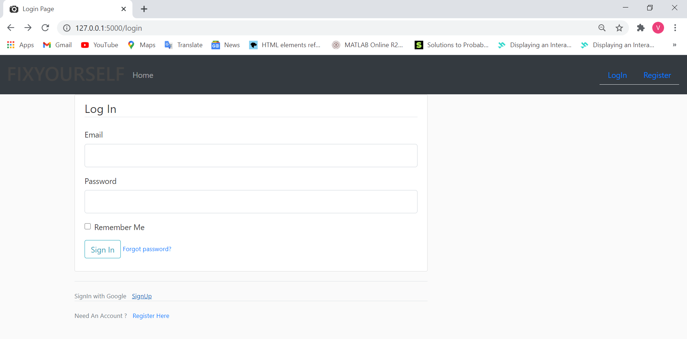
Logging in a user using OAuth2 by their Google account
Step 1 going to the Sign Up Page and selecting Sign Up with Google

Slide 10
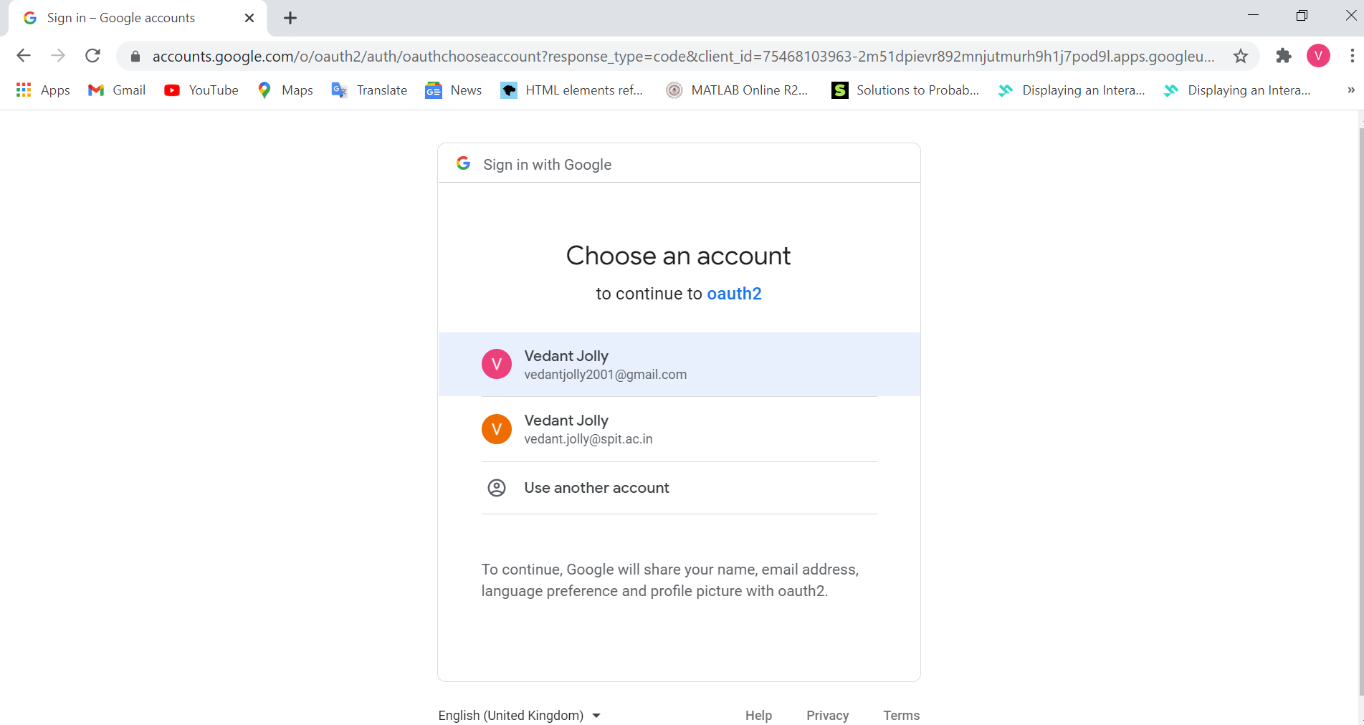
Continued…
Step 2: Selecting your account and logging in our website
The database/account of the User is automatically created in the Backend

Slide 11
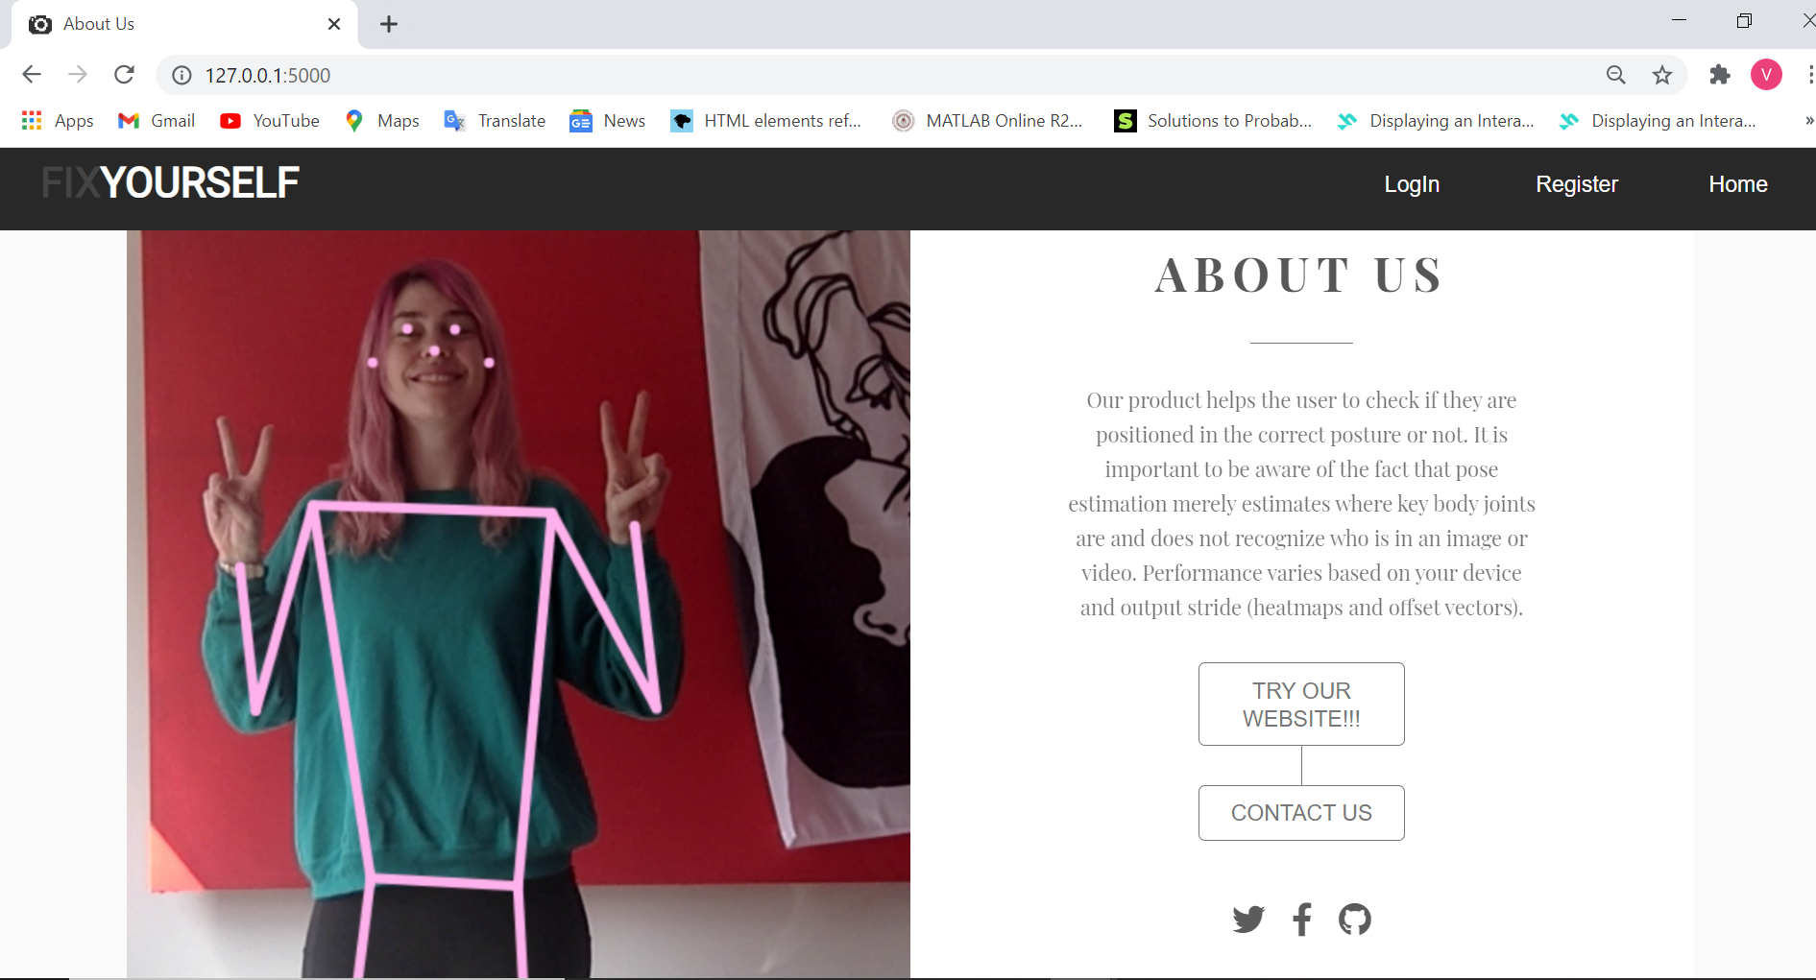
Home Page of our Web Site

Slide 12
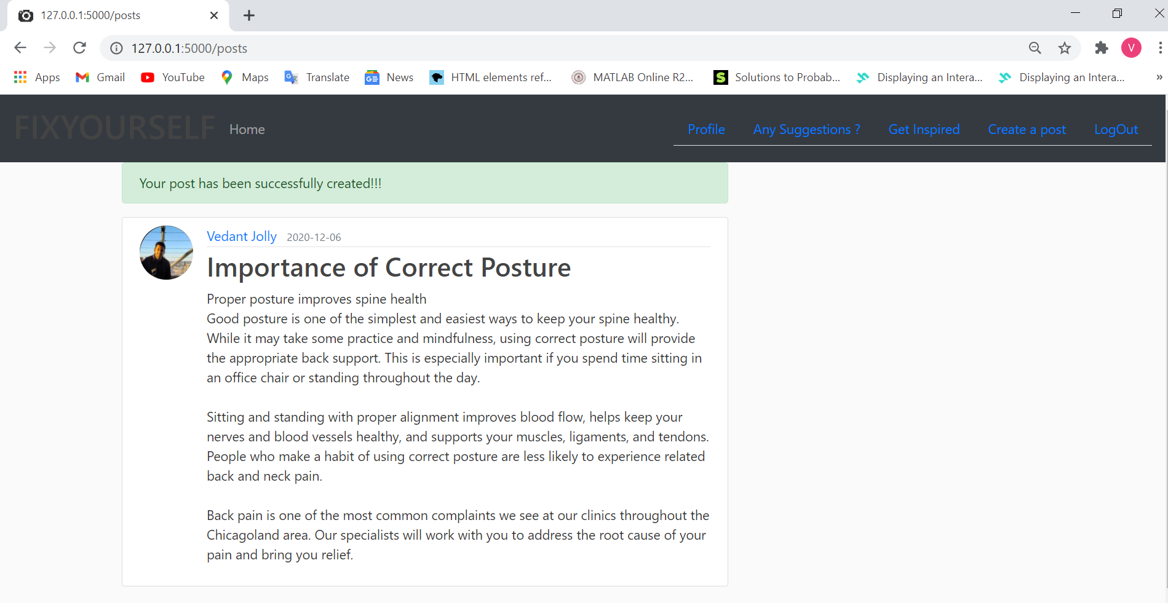
Reading as well as Sharing of posts
As said earlier we don’t want our users to only our app we also want them to contribute towards well beings so for that we have put a feature where people can post as well as read other people articles.

Slide 13
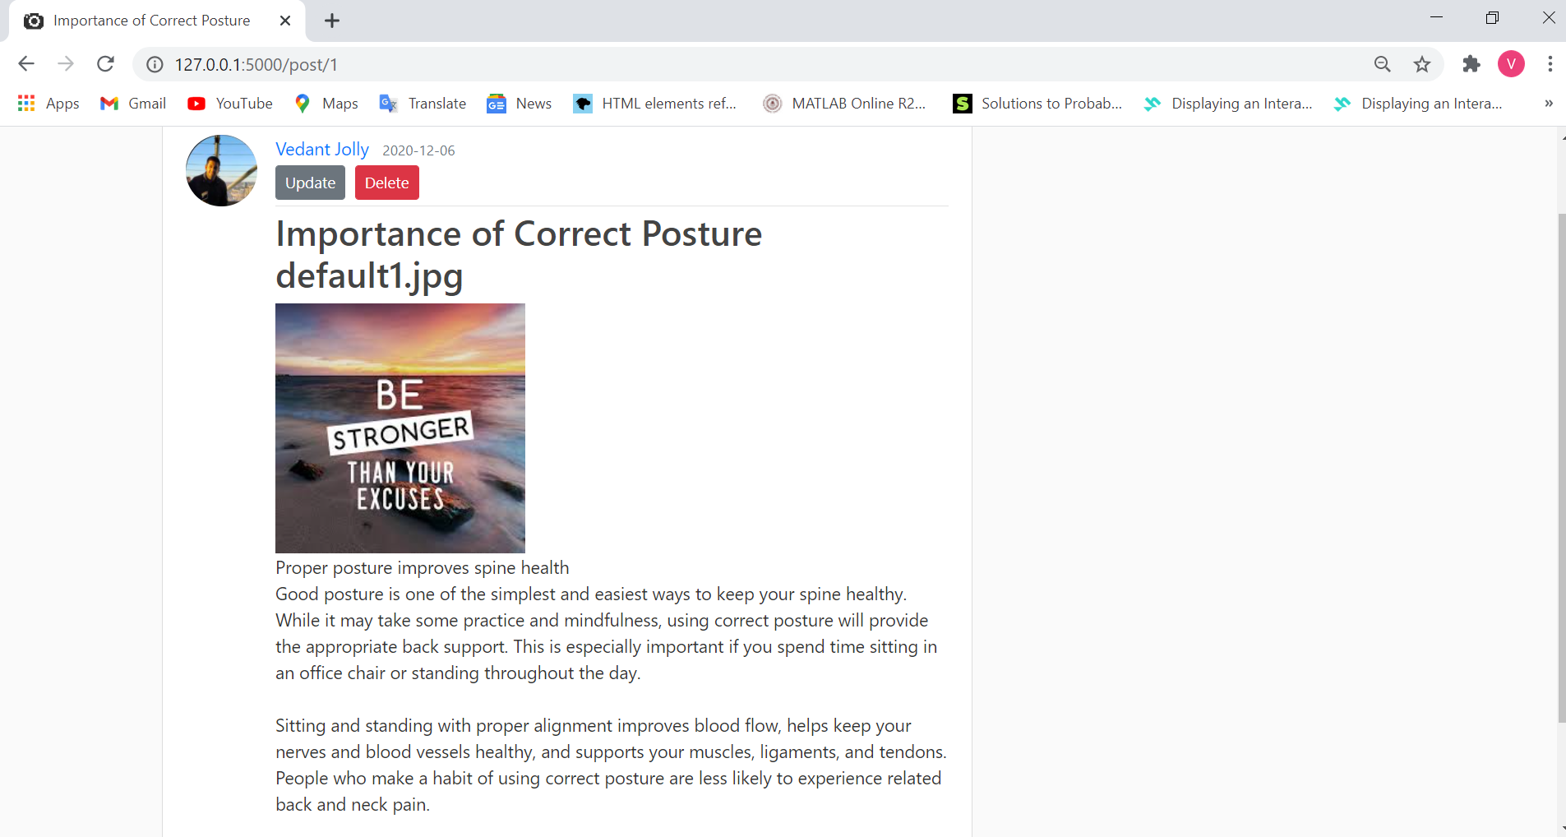
Update a post
A user who has created the post can only delete or update their post

Slide 14
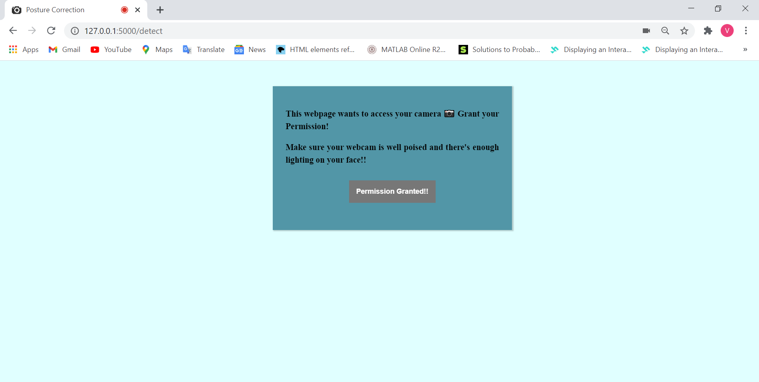
Our Main Application !!!
User just has to click Try our website and allow the camera to start for using our application

Slide 15
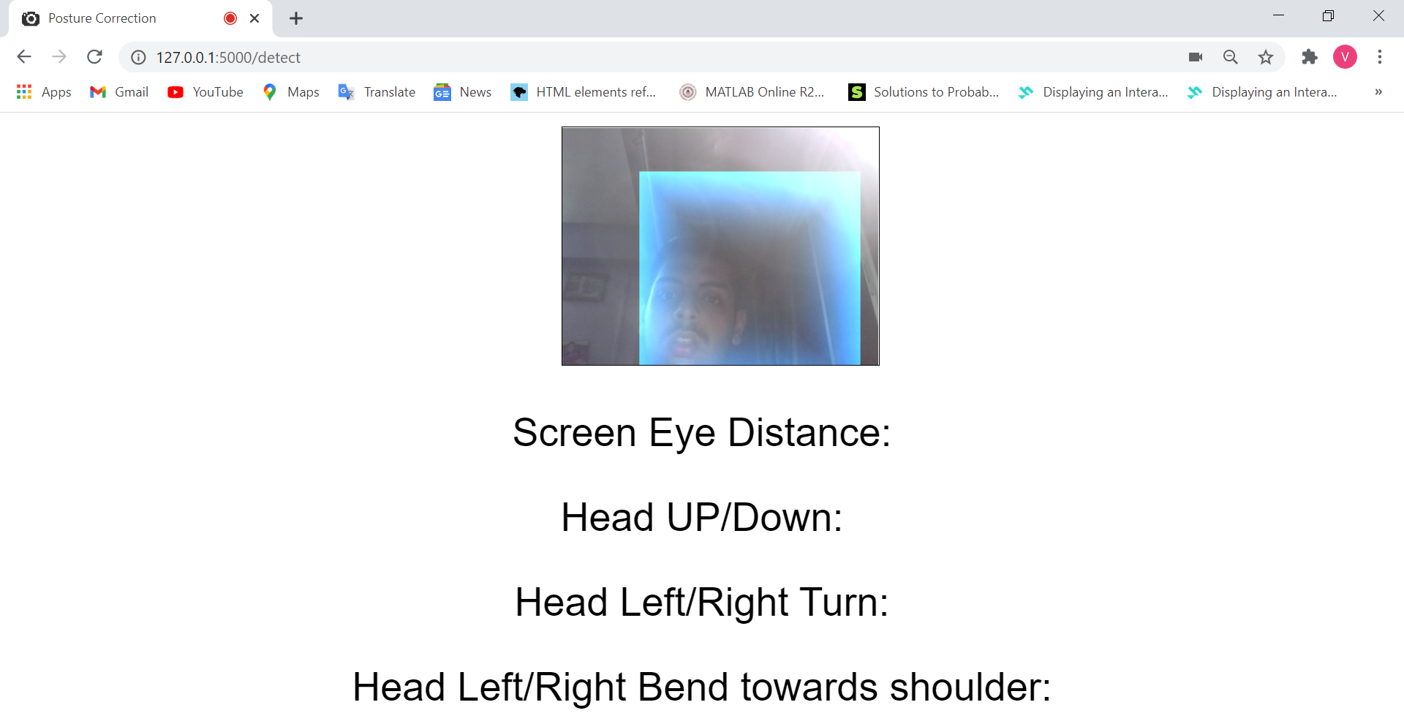
How does it Detect ?
Step 1 of our algorithm is to detect the user’s face

Slide 16
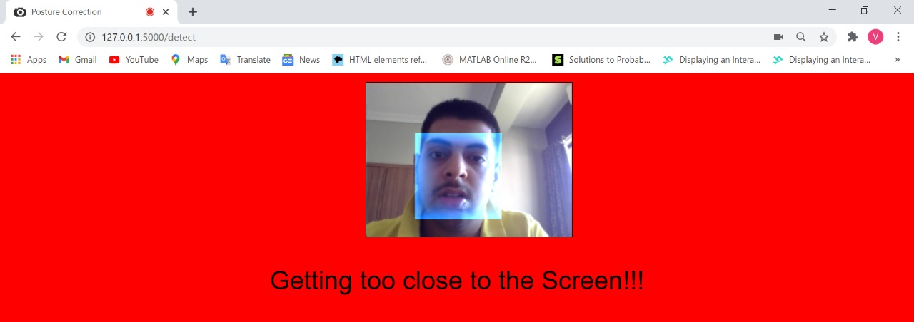
Face Detected!!!!
Different Types of error
Step 2: Correct our posture according to the instructions flashed
When the user gets too close to the screen.

Slide 17
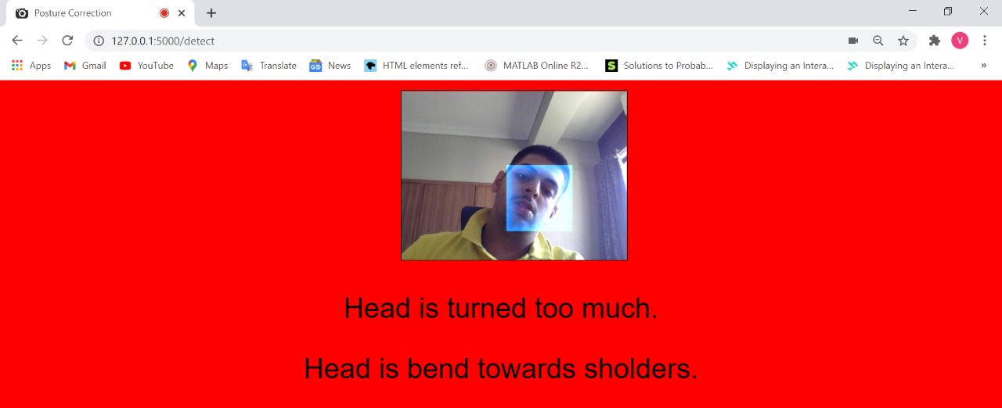
When the head is turned too much.
When head is bend towards the shoulders.

Slide 18
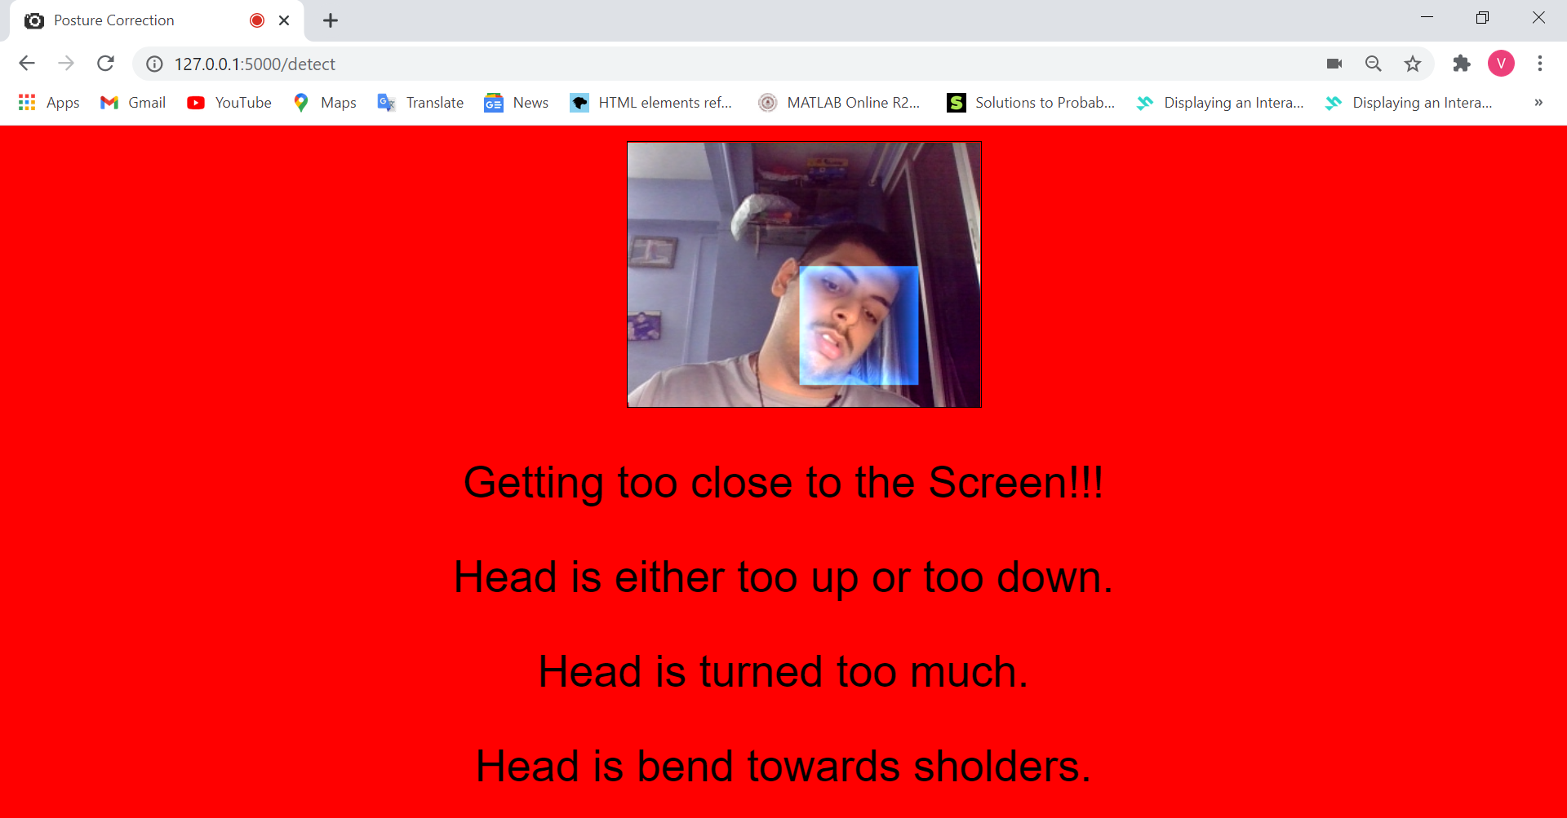

Slide 19
Voila !!! Posture Corrected
Step3 : After we follow the steps and sit accordingly then the screen will stop flashing errors

Slide 20
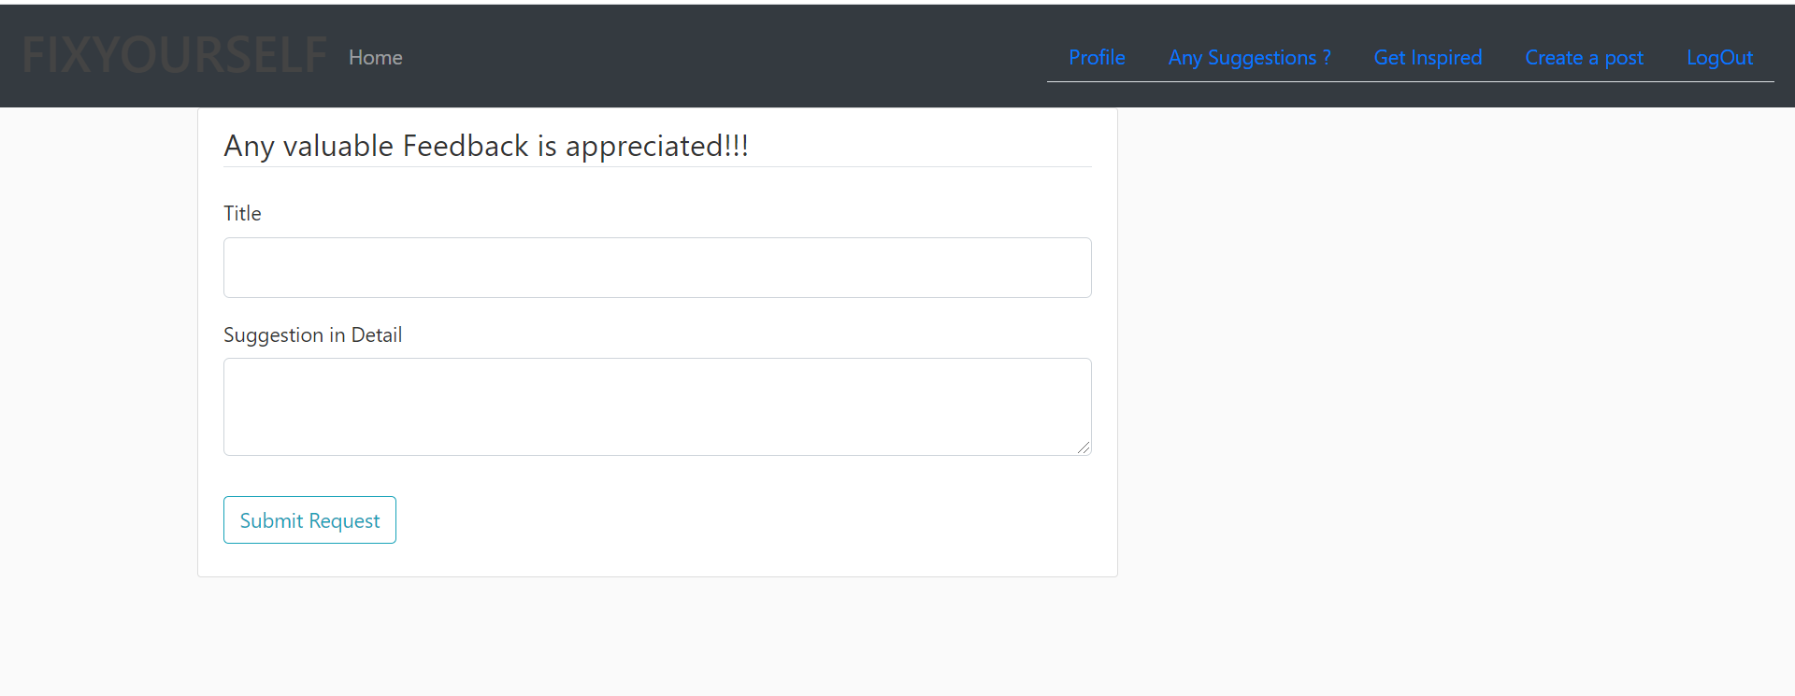
Feedback Appreciated
We want our users to experience the best and so for any glitch or some other stuff the can contact us by simply pressing the contact us tab or Any Suggestions tab

Slide 21



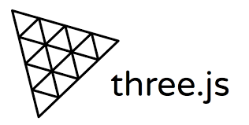



Tec Stack Used

Slide 22
Future Scope
We hope to further improve this website by adding a dashboard feature to our users. This feature will send push notifications to users who spent a certain amount sitting in order to take a short break and purse working after the break.
The website will display a two-dimensional bar chart to simplify the comparison between straight time and slouching time. This chart can be shared in social media channels or emailed to the user’s physician for further reference.

Slide 23
A further point of upgradation is that it displays a two-dimensional stacked area chart for the straight sitting time and the slouching time for the current day, a week, and one month according to the requirement of the user.
We hope to further improve our website by providing a statistical data on what kind of bad posture a user has been while working.

Slide 24
Further features to be added
Smart Hide - Detects if you have been idle/away from the computer and will not show reminders until you return. If your computer is locked, notifications will restart when you are active again.

Slide 25

Any Questions?

